Slide 1

FEATURE FILM ROI
Torin Rettig

Slide 2
PROJECT GOAL
Predict ROI on film budget based on data available on IMDb

Slide 3
MOTIVATION
Filmmaking is an expensive, high-stakes endeavor.
Film companies and filmmakers put a great deal of focus on financial performance.
Identifying factors for financial success could provide valuable insights for the business.

Slide 4
METHODOLOGY
Gather data on films that is available on IMDb and IMDbPro.
Select films that have completed their box office run.
Select features related to both financial performance and popularity.

Slide 5
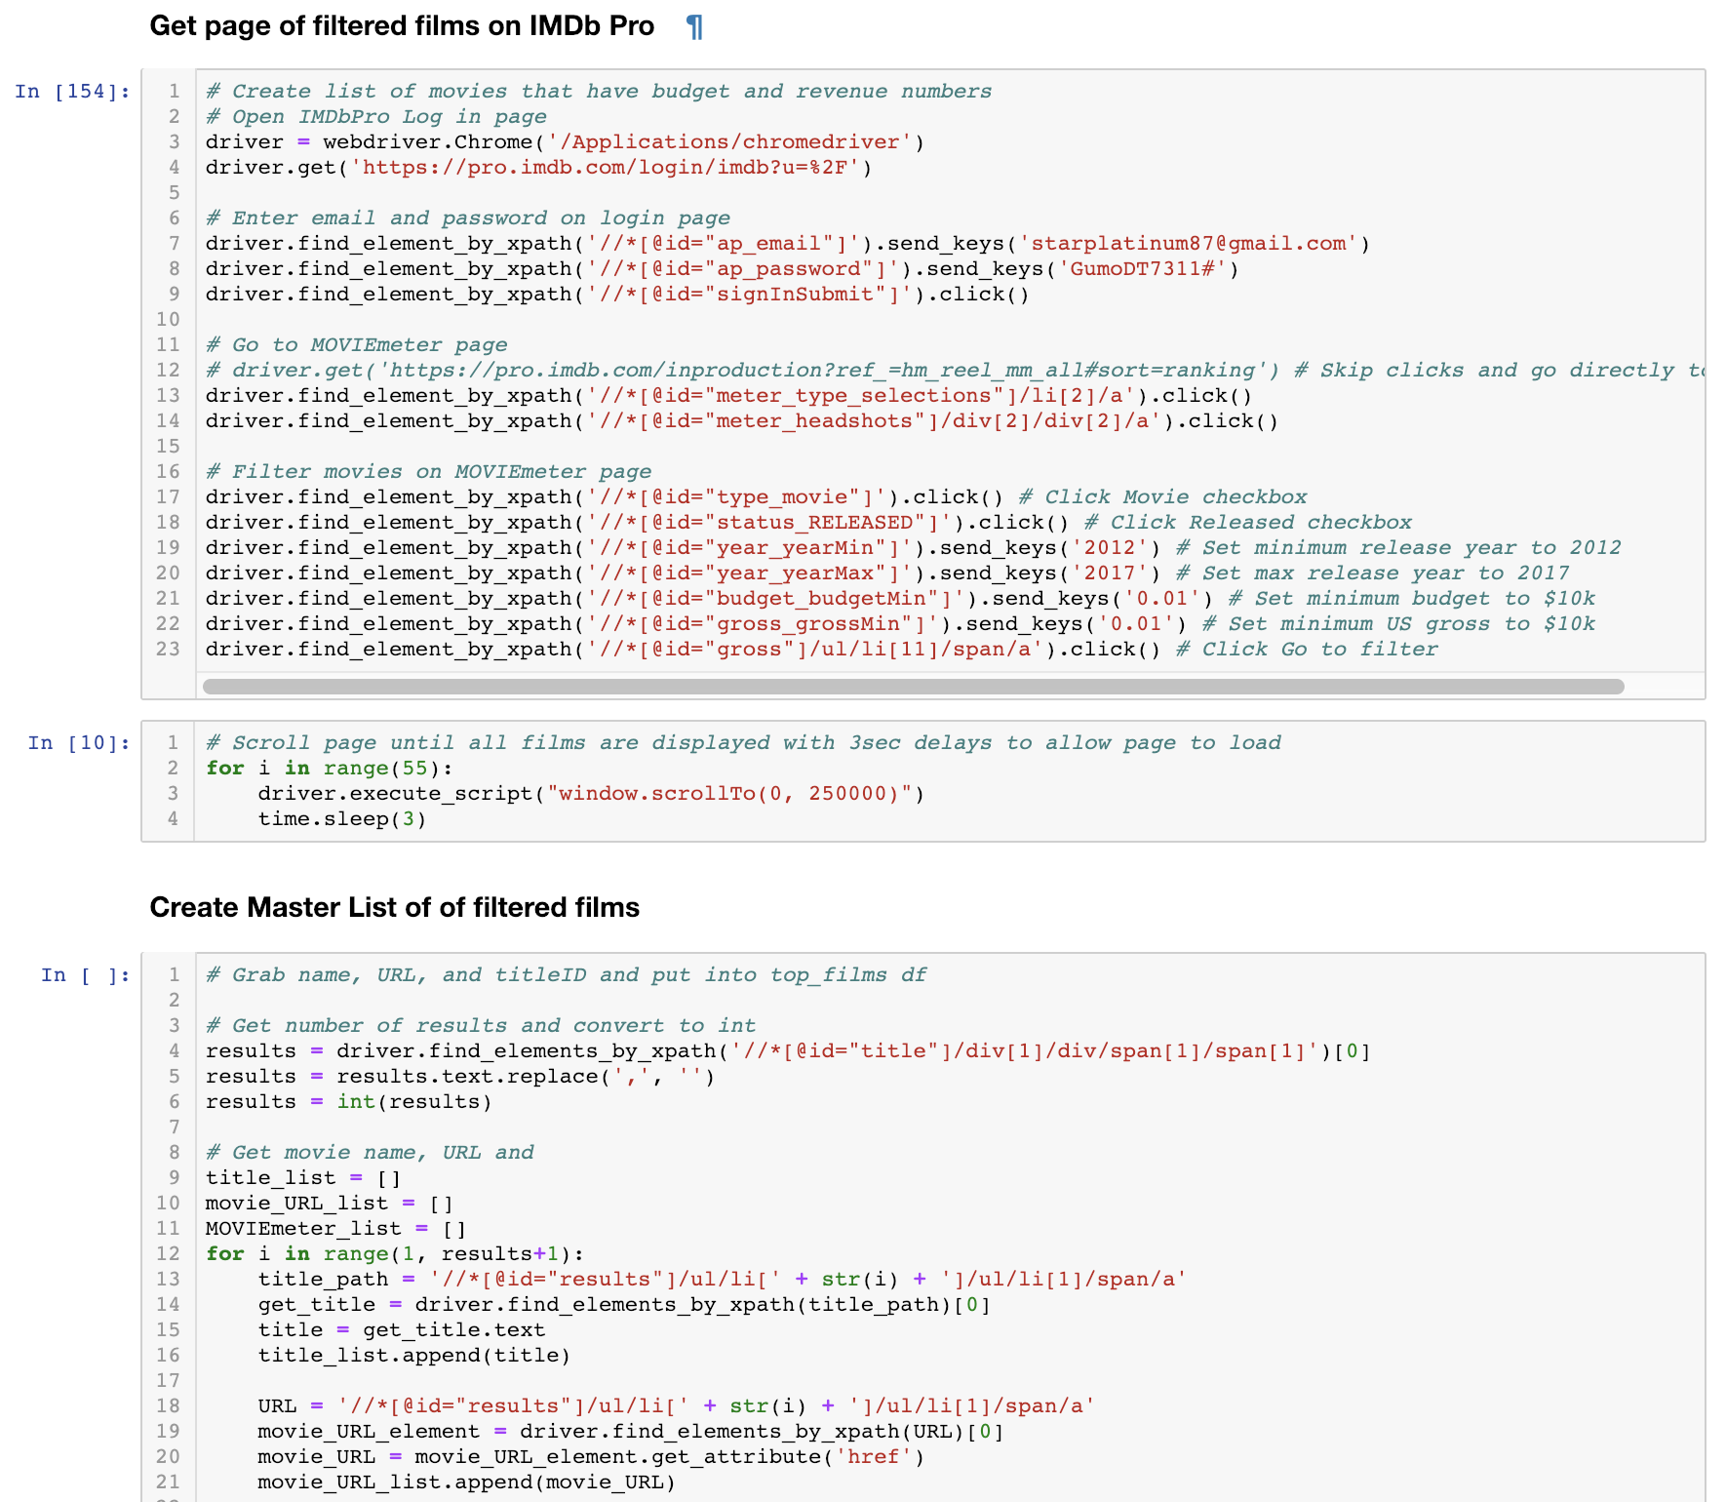
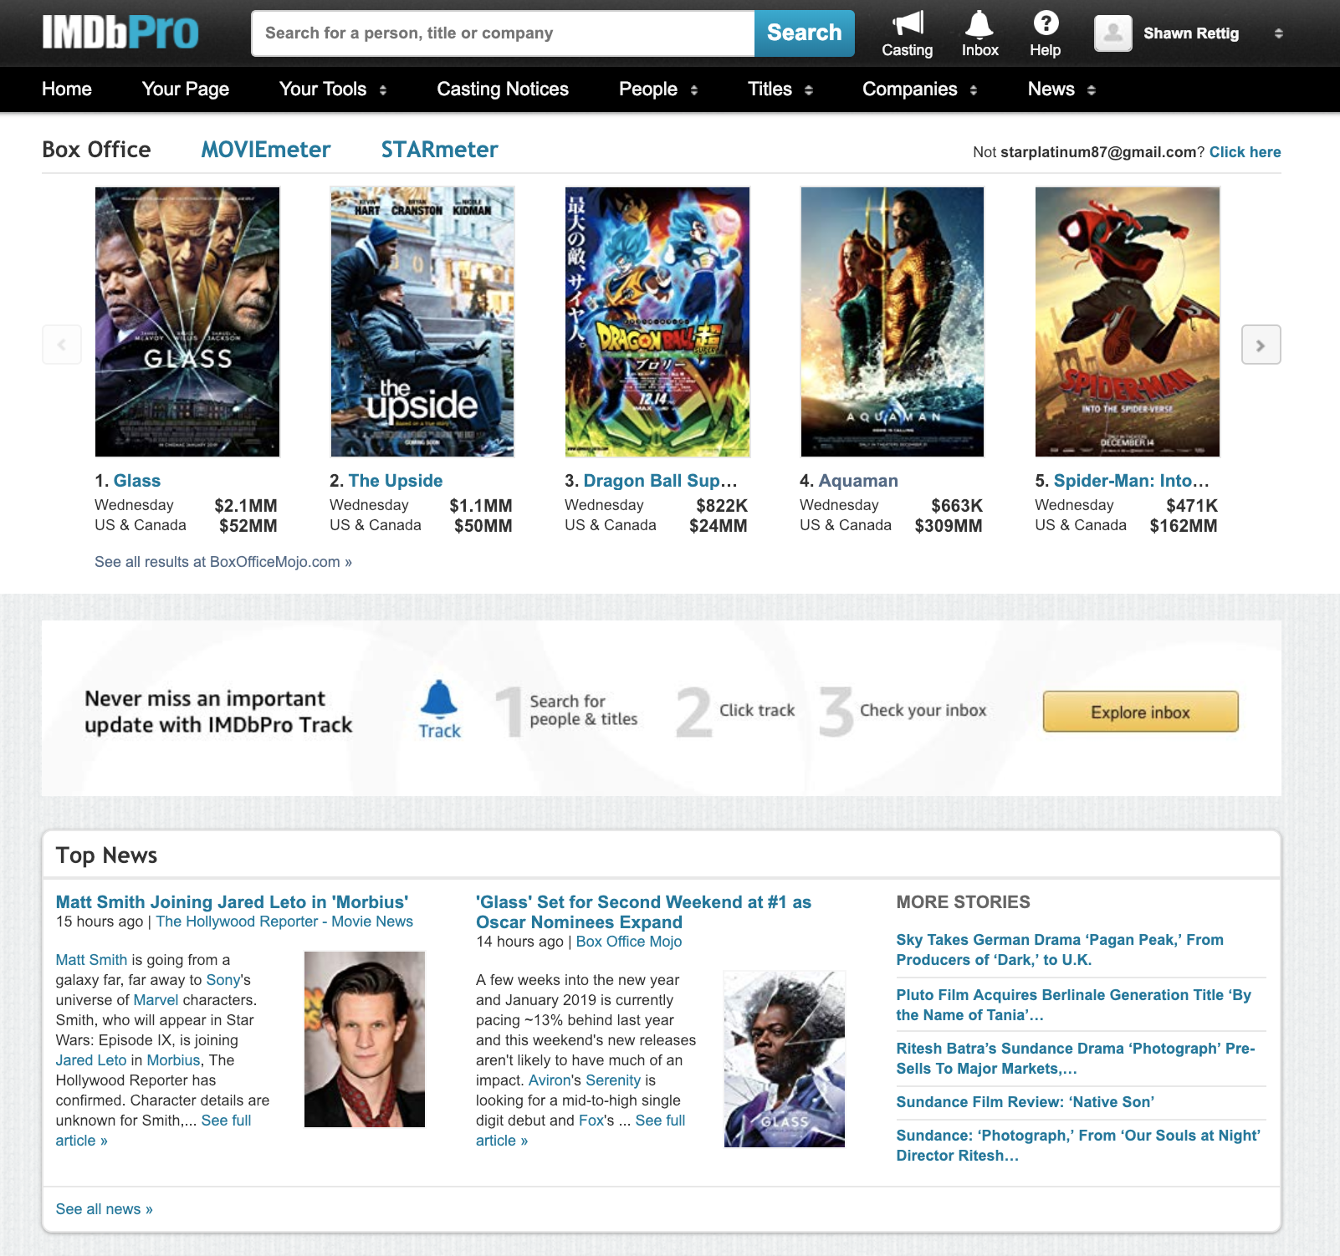
WEB SCRAPING
SELENIUM
1300+ Pages

Slide 6
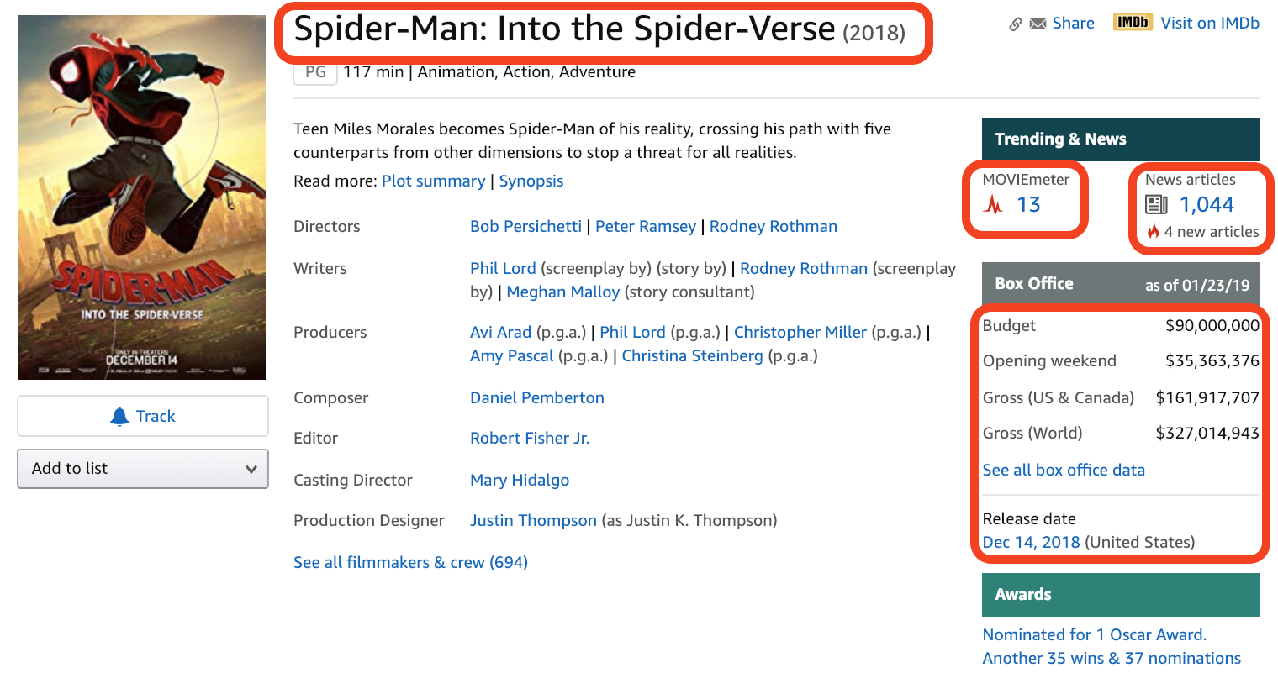
DATA COLLECTION

Slide 7
ANALYSIS
1319 Observations: Films
Target: Gross Revenue / Budget
7 Features:
Budget
Opening Weekend
MOVIEmeter
Ratings
Votes
Articles
Opening / Budget

Slide 8
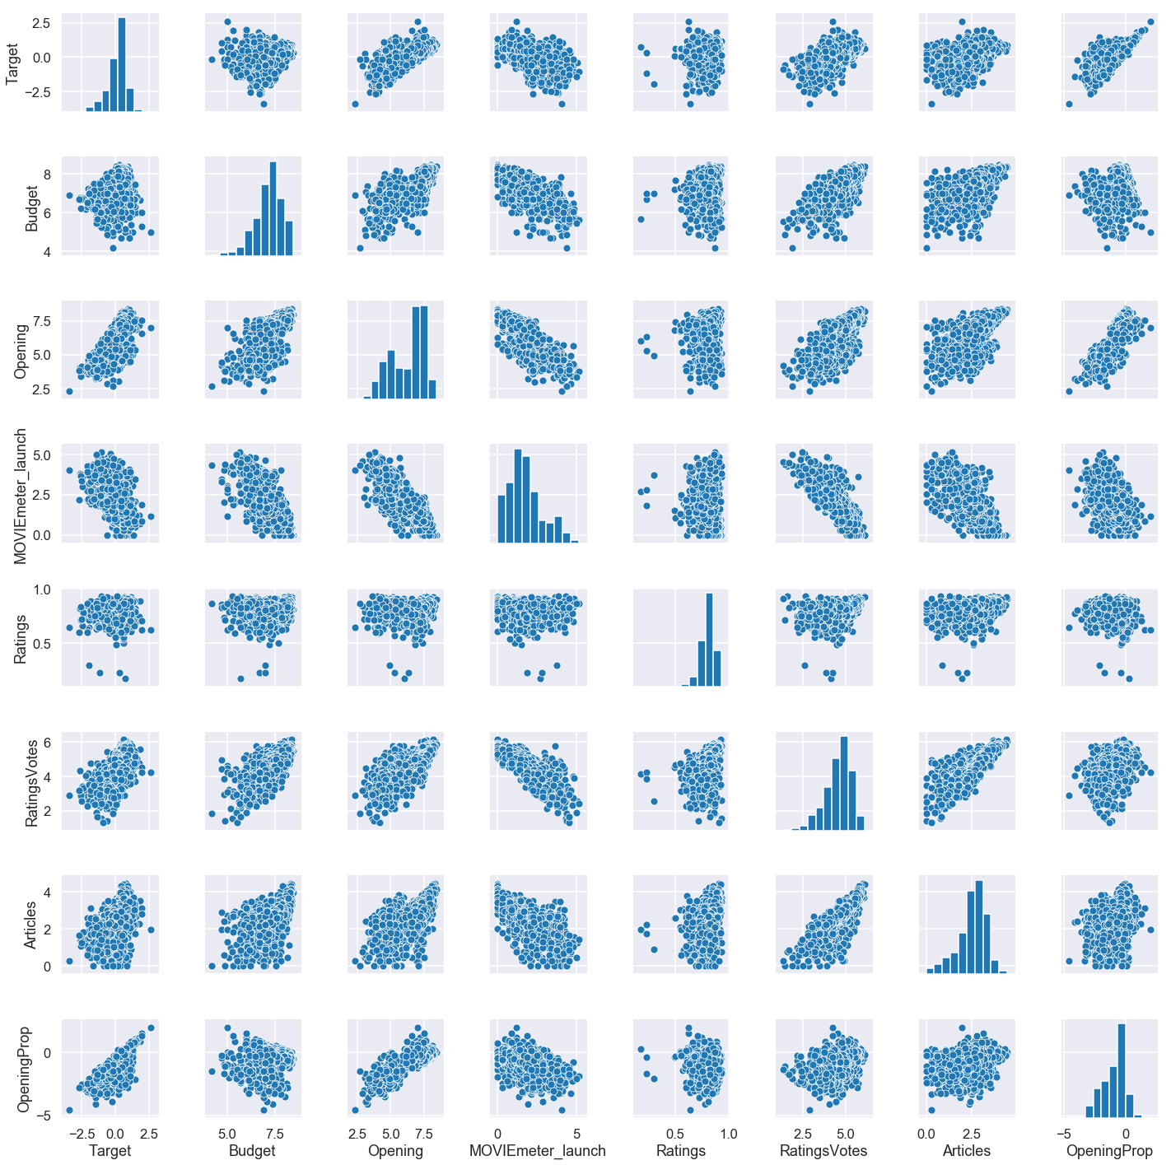
ANALYSIS
Log Transform
Notes:
Target/OpeningProp
Target/RatingsProp
Target/Opening
RatingsVotes/MOVIEmeter_launch
Budget/RatingsVotes
Opening/OpeningProp
Budget/MOVIEmeter_launch
Articles/RatingsVotes

Slide 9
BASIC TRAIN-VALIDATION-TEST
Standard Scaled 60/20/20
Linear Regression: 0.686
Ridge Regression: 0.686
Degree 2 Polynomial: 0.235
Keep these values in mind for later
Notes:
Basic 60/20/20

Slide 10
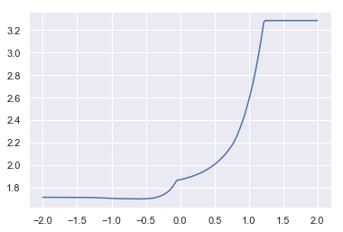
REGULARIZATION – TUNE ALPHA
Validation
Error Plot
Alpha Value = 0.23272

Slide 11
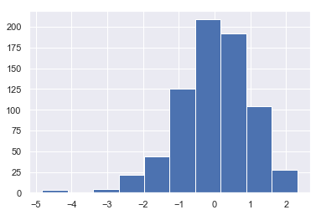
REGULARIZATION - LASSO SCALED
LASSO
60/20/20
Alpha = 0.2327
Budget: -0.0
Opening: -0.0
MOVIEmeter launch: -0.00
Ratings: 0.5671
RatingsVotes: 0.4036
Articles: 0.0
OpeningProp: 16.4261

Slide 12
REGULARIZATION – AUTOMATED
Alpha = 0.01
Budget: -0.0116
Opening: -0.2659
MOVIEmeter launch: -0.1151
Ratings: 0.7239
RatingsVotes: 0.8271
Articles: -0.1498
OpeningProp: 16.6904
LASSO CV
Keep features!

Slide 13
TEST RESULTS
Basic T/V/T Linear Regression: 0.580
Ridge CV Regression: 0.6961
LASSO CV Regression: 0.6952
Ridge is slightly better, but they are both nearly identical.

Slide 14
CONCLUSIONS
Certain features seem more strongly predictive than others.
All features together seem to have cumulative predictive effect that is strongest.
Both LASSO and Ridge CV were nearly identical, but LASSO is thought to be better suited for models with fewer features, so we’ll go with LASSO.

Slide 15
THANK YOU!

Slide 16
Q & A
QUESTIONS

Slide 17
APPENDIX

Slide 18
FUTURE WORK
More Features: Gross +1 Month, Principal Cast Details, Metacritic, Season, Month, Holiday, Genre, etc.
Add trends information on revenue and other details.

Slide 19
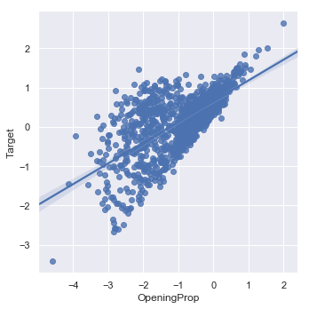
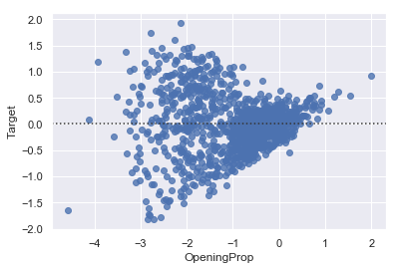
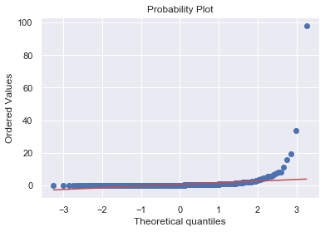
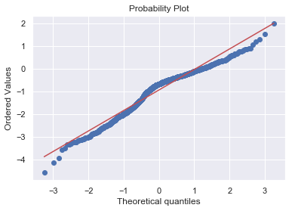
ANALYSIS
Opening | Target

Slide 20
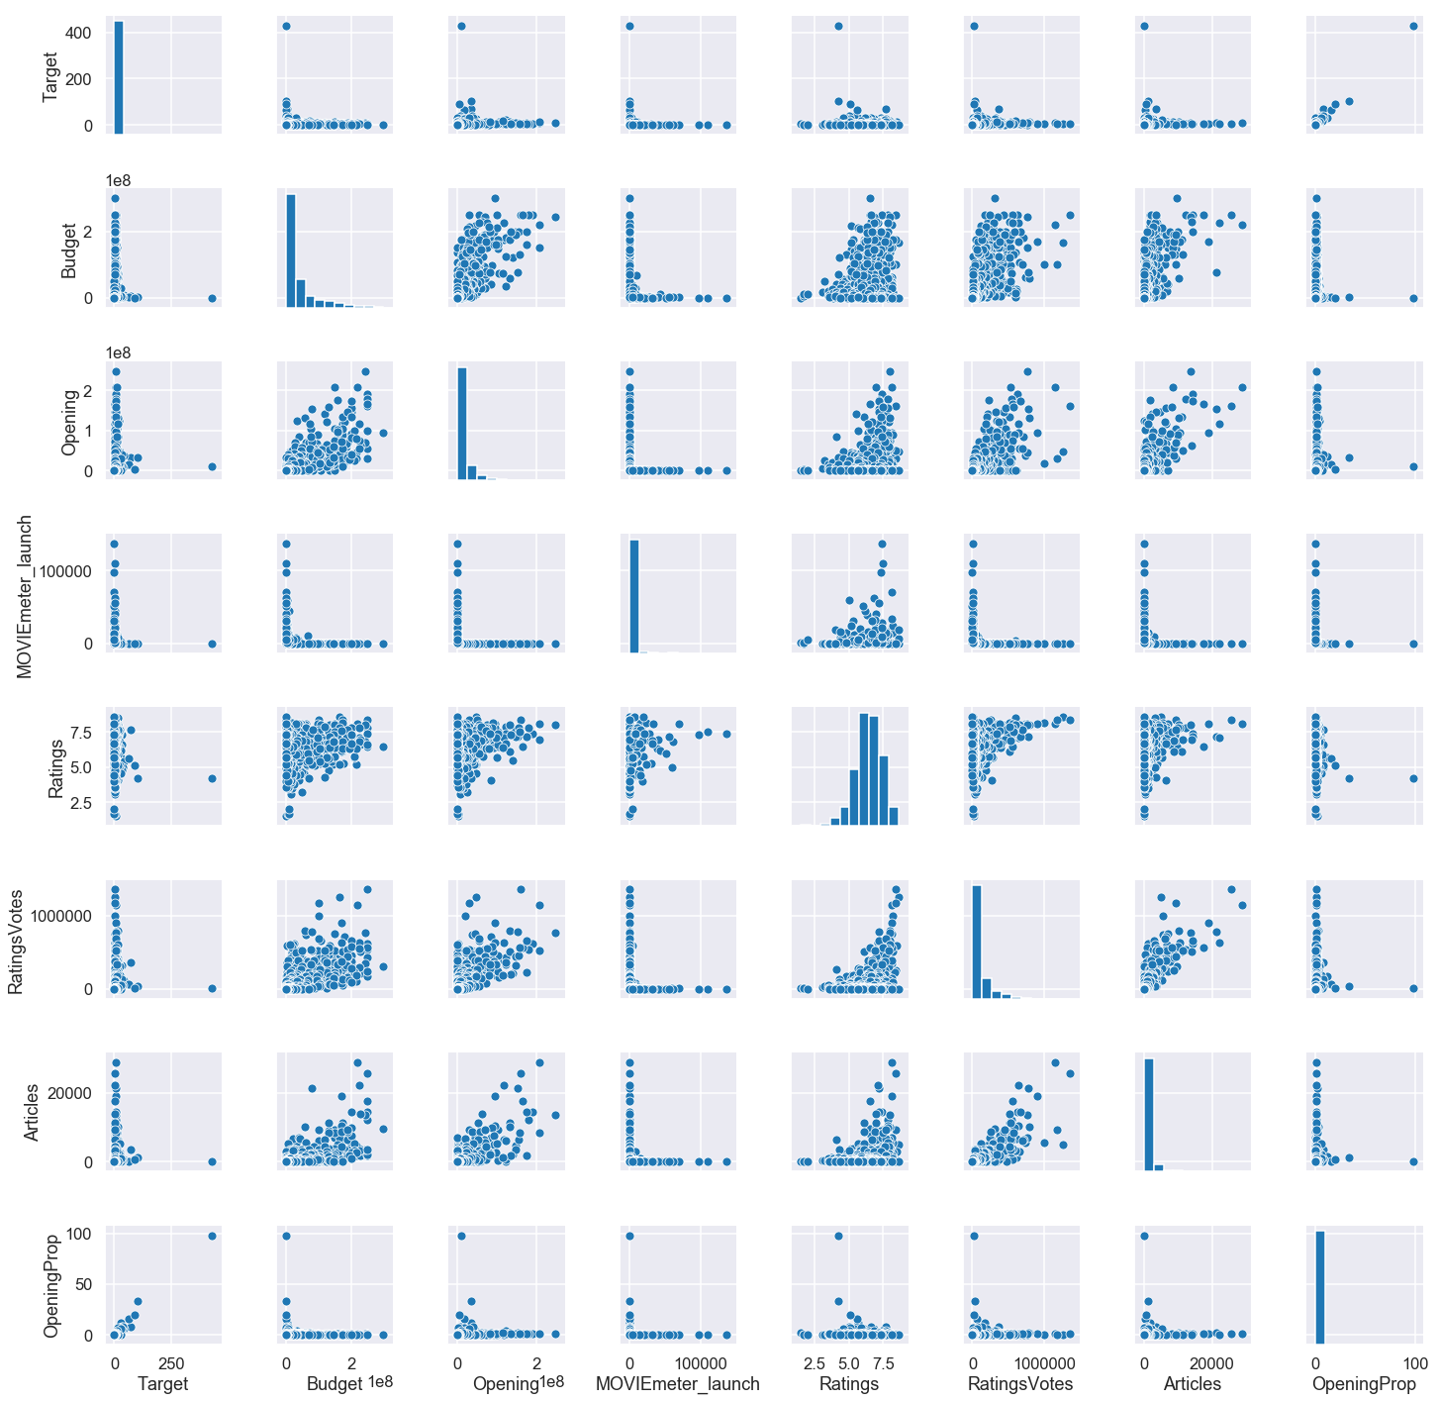
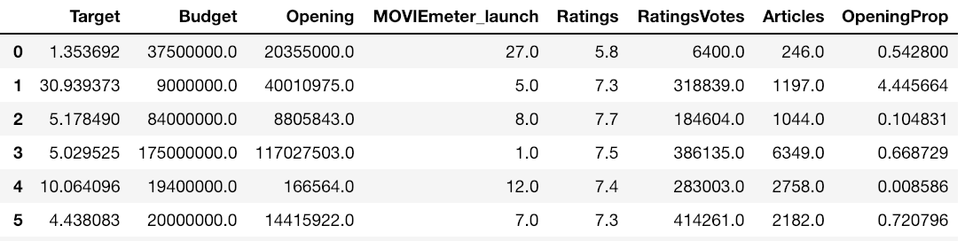
ANALYSIS
Data at Different Scales

Slide 21
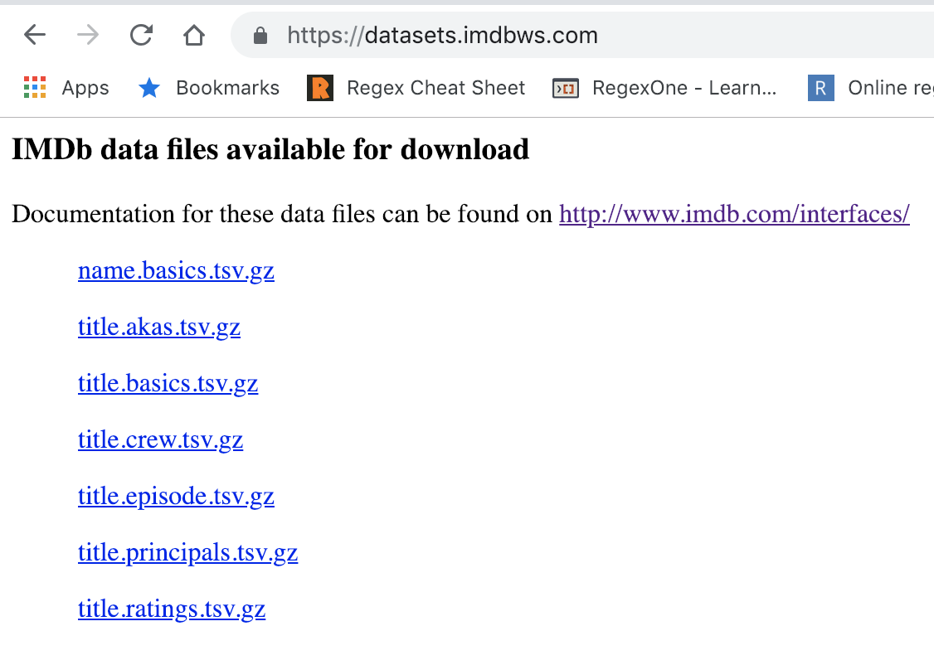
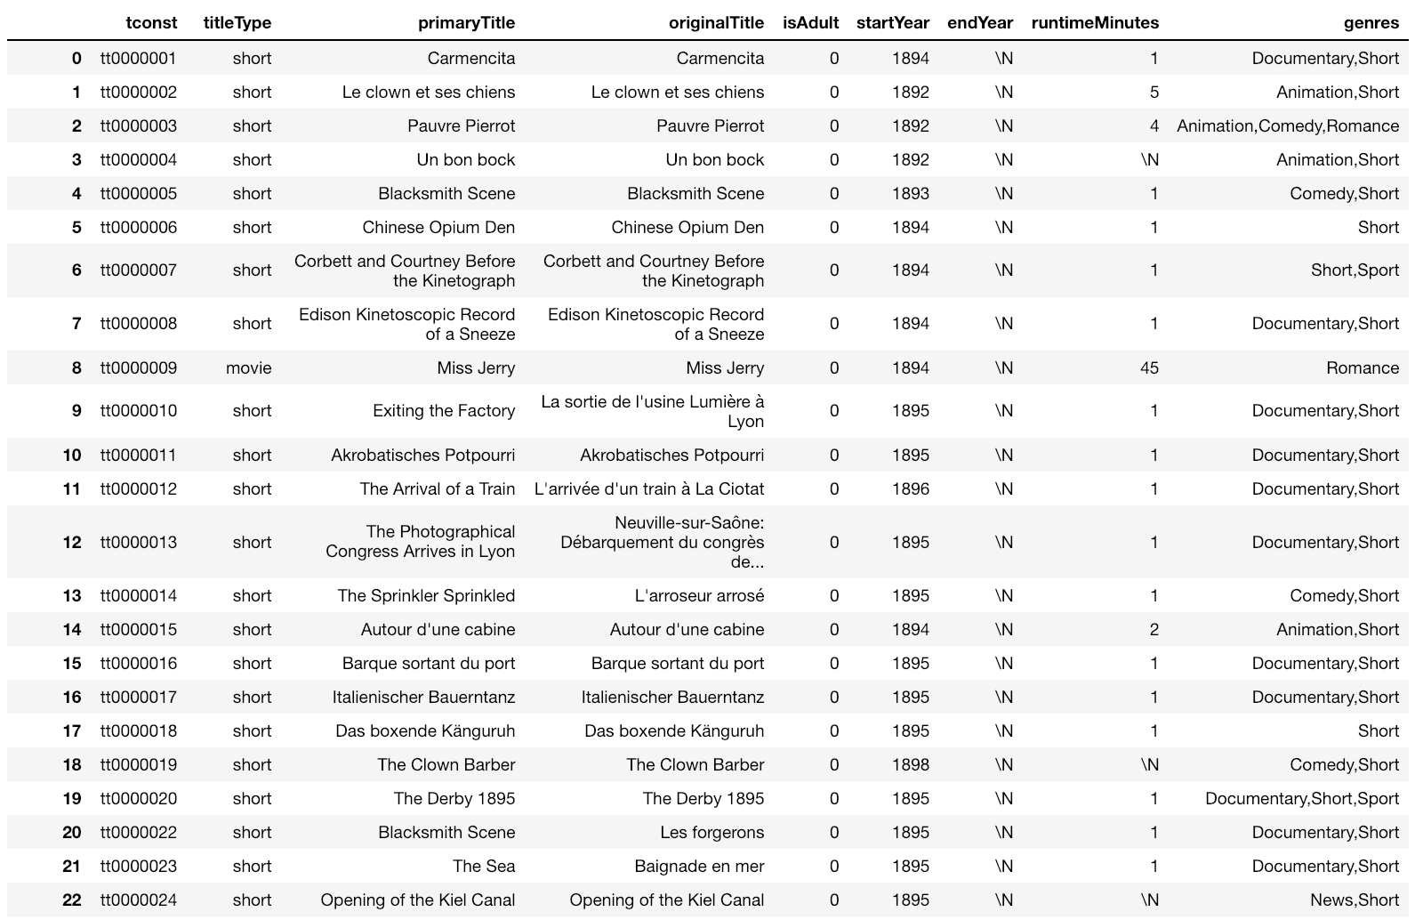
DATA COLLECTION
IMDb TSVs
DataFrame

Slide 22
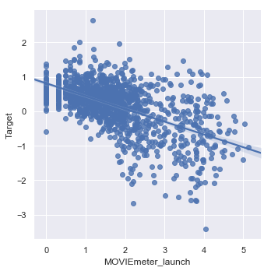
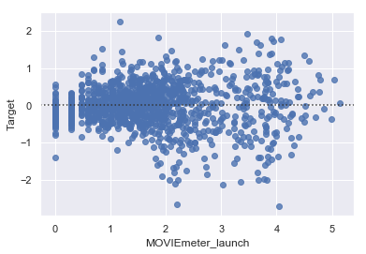
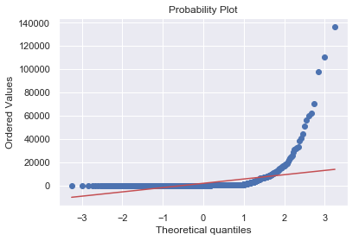
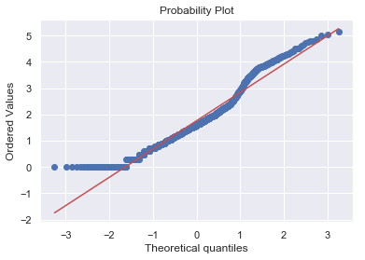
ANALYSIS
MOVIEmeter | Target

Slide 23
REGULARIZATION - LASSO SCALED
LASSO
60/20/20
Alpha = 0.2 (Arbitrary)
Budget: -0.0
Opening: -0.0
MOVIEmeter launch: -0.00
Ratings: 0.5956
RatingsVotes: 0.4235
Articles: 0.0
OpeningProp: 16.4626

Slide 24
REGULARIZATION - LASSO
Alpha = 0.2
R^2 Score: 0.6984~
Budget: -0.00
Opening: -0.00
MOVIEmeter launch: -0.00
Ratings: 0.72
RatingsVotes: -0.00
Articles: -0.00
OpeningProp: 4.22
LASSO
60/20/20

Slide 25
Feature Engineering – Interactions
R^2 Score: 0.6984~
Opening: -0.00
MOVIEmeter launch: -0.00
Ratings: 0.77
RatingsVotes: -0.00
Articles: -0.00
OpeningProp: 4.22
Ratings_x_Votes: -0.00
Ratings * Votes
Split & Validate

Slide 26
REGULARIZATION – AUTOMATED
Alpha = 0.01
Budget: -0.0246
Opening: -0.272
MOVIEmeter launch: -0.1252
Ratings: 0.7287
RatingsVotes: 0.8713
Articles: -0.1844
OpeningProp: 16.6902
RIDGE CV

